Slide 1
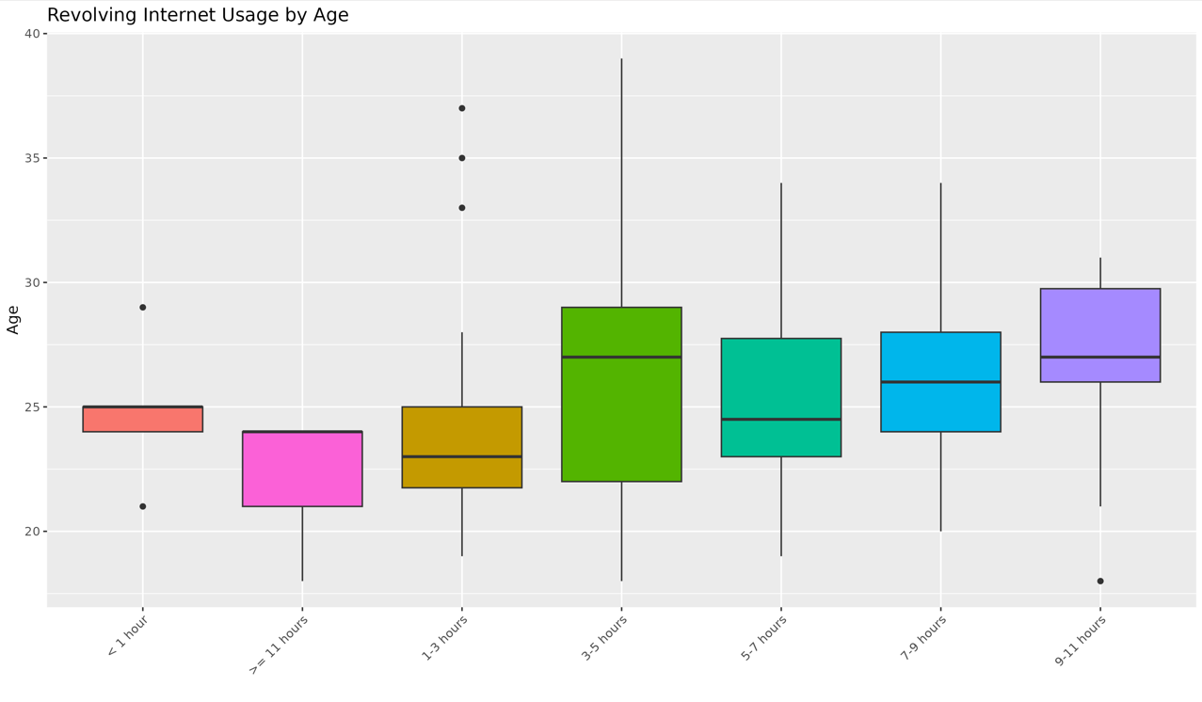
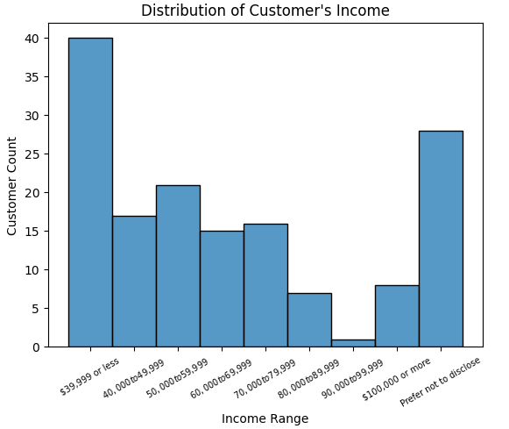
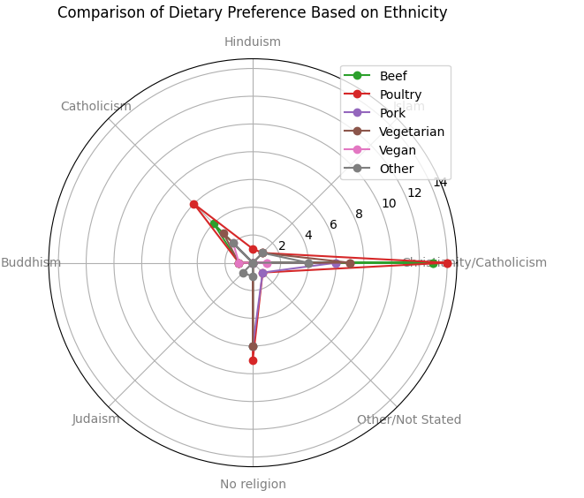
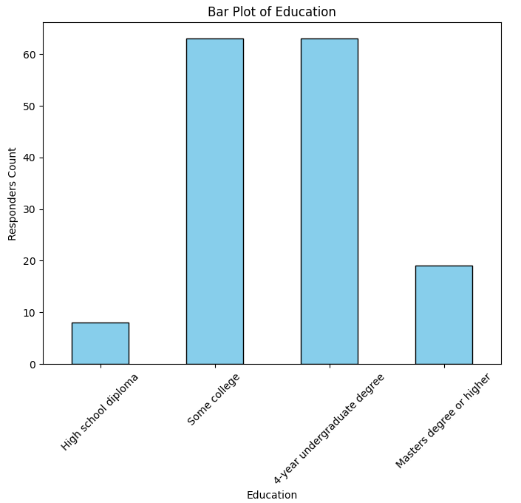
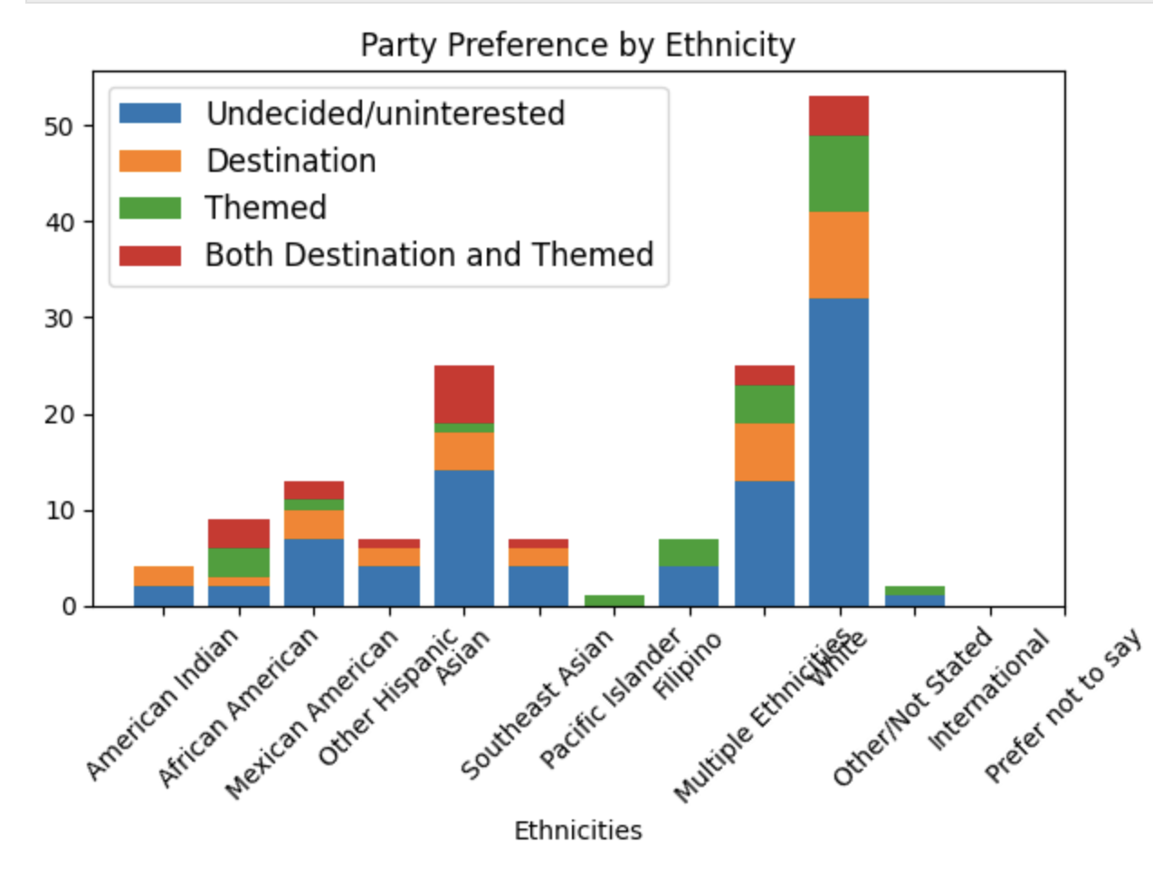
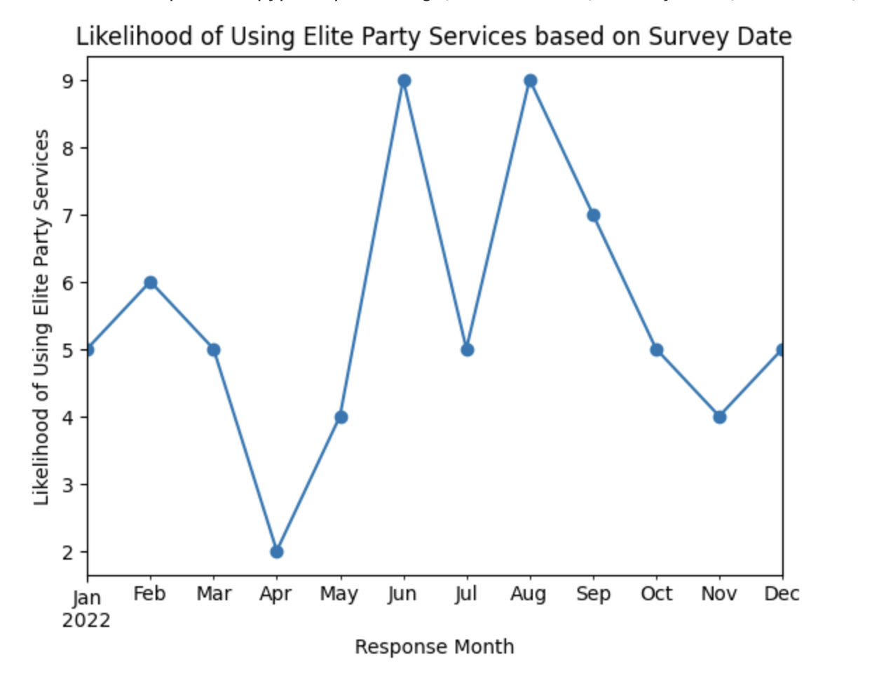
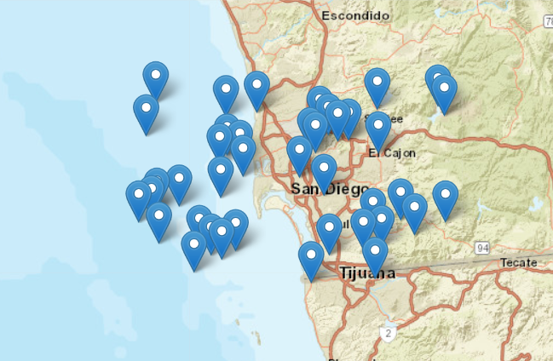
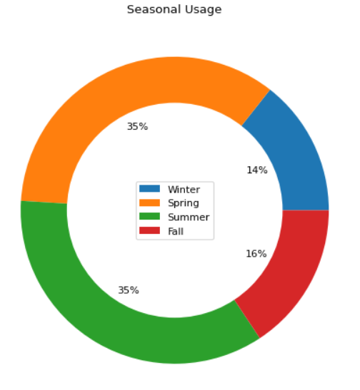
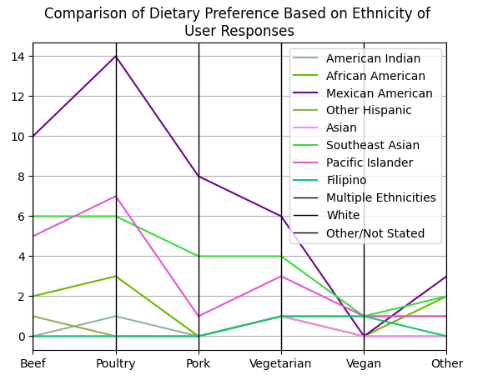
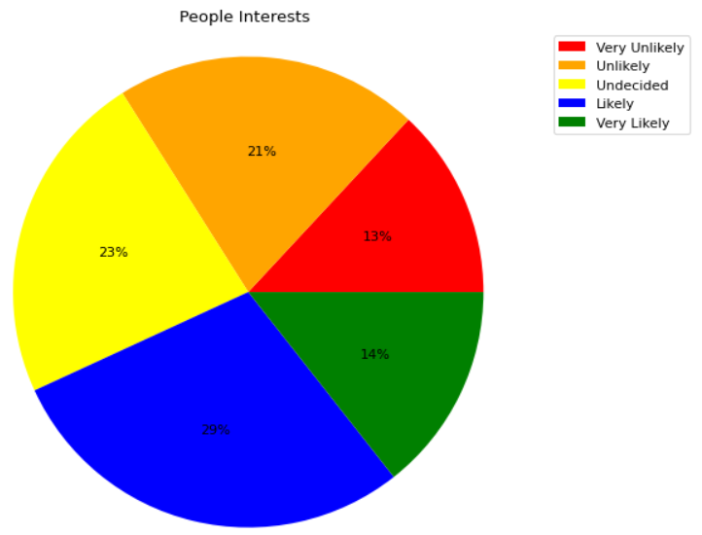
From the data visualizations under Distribution of customer’s income, income groups less than 39,999 is the majority with a count of 40 customers
14
ELITE PARTY SERVICES
12
In the chart, most customers (55) use the internet for 3 to 5 hours, which is 50% more than the next group using it for 5 to 7 hours.
13
1
"Elite Party Services" entail an elevated approach to event planning, providing exclusive and premium offerings for diverse occasions. These services encompass personalized event coordination, carefully curated venue choices, and sophisticated solutions, ensuring a memorable and refined experience for clients seeking a higher level of celebration and hospitality.
11
2
These findings indicate that majority of the target audience are in “Some College” and “4-year undergraduate degree” groups, where as “High school diploma“ group is lowest.
10
9
15
19
20
16
Christianity/Catholicism tops in poultry and beef preference among religions on the radar plot. Hinduism has the least meat preference, Buddhism opts for vegan only, and Judaism and Islam prefer other dietary choices.
Majority of responders are uninterested while responders reported as “White” is the majority group who are equally interested in themed and destination parties.
3
4
The data indicates a rise in the likelihood of utilizing elite party services from April to June, reaching its peak in June, and subsequently decreasing from August to November. The lowest likelihood is in April.
In the spring and summer, 35% of people choose to use Elite Party Services. Winter is the least popular season, with 14%, while fall is in the center with 16%. This is most likely due to the fact that more outside activities take place in the spring and summer when the weather is good.
8
18
21
Poultry is the favorite choice of White, Asian, and Multiple Ethnicities, with vegetarian options being preferred by White and Multiple Ethnicities. Asians have a smaller proportion of vegetarians and vegans.
This shows that the majority of consumers are likely to use Elite Party Services with 14% very likely and 29% likely contributing to 43% in total. Furthermore outnumbering those (13%) who are strongly uninterested.
7
17
Elite party services' focus groups are in San Diego, and surrounding businesses such as Taylor Research, Elite Lifestyle Management, Campaign Creators, Billy Gene Is Marketing Inc, and Elite Security & Staffing provide services.
22
6
5

